Slide 1
prediction Coronary Heart Disease Risk using machine learning Techniques

Slide 2
Abstract
Heart disease is one of the most significant causes of mortality in the world today. Prediction of cardiovascular disease is a critical challenge in the area of clinical data analysis. The diagnosis of heart disease through traditional medical history has been considered as not reliable in many aspects. The health care industry produces a huge amount of data and these data is not always made use to the full extent and is often underutilized. Using this huge amount of data, a disease can be detected, predicted or even cured. In this project, we have developed a Machine Learning based diagnosis system for heart disease prediction by taking the help of medical data such as Blood pressure, cholesterol, body mass index, smoking habit, heart rate etc as input and then these features are modelled for prediction. This model can then be used to predict future medical data. Here we perform the comparative analysis of the algorithms like decision tree, Naïve Bayes, Logistic Regression, KNearest Neighbors .Then the accuracy of the model using each of the algorithms will be calculated and the one having the best accuracy will be taken as the model of predicting the heart disease and finally a GUI will be designed to predict the disease.

Slide 3
Objective
In this project the task is to predict whether a person is going to have coronary heart disease or not in upcoming 10 years by using 6 popular machine learning algorithms.
These are logistic regression, K Nearest neighbours, Naïve bayes , Decision tree ,Support vector machine and random Forest algorithm.
After implementing these algorithms, the best model will be found for heart disease prediction. A graphical user interface will be designed for to make prediction for new dataset.

Slide 4
Coronary Heart Disease
Also known as coronary artery disease (CAD), is a condition where the
coronary arteries (the blood vessels that supply oxygen rich blood to the heart vessels) becomes narrowed/blocked due to the buildup of plaque (a mixture of fat, cholesterol, and other substances).
An artery is a type of blood vessel that carries oxygen-rich blood away from the heart to all parts of the body — such as your brain, kidneys, muscles, and other organs.
Imagine a water pipe that carries clean water to your house.
If dirt or grease builds up inside the pipe, the water can’t flow smoothly — and pressure builds up.
Similarly, when cholesterol and fat block an artery, your heart has to work harder to push blood, increasing the risk of heart problems.

Slide 5
HOW IT DEVELOPS????
Plaque formation (Atherosclerosis):
Cholesterol and fatty substances gradually build up on the inner walls of the coronary arteries.
Narrowing of arteries:
The buildup makes the arteries stiff and narrow, reducing blood flow to the heart.
Reduced oxygen supply:
When the heart doesn’t get enough oxygen, it can cause chest pain (angina) or even a heart attack (myocardial infarction) if a plaque ruptures and completely blocks blood flow.

Slide 6
Major Symptoms:
-Chest pain or pressure (especially during activity)
-Shortness of breath
-Fatigue
-Dizziness
-Heart attack (in severe cases)

Slide 7
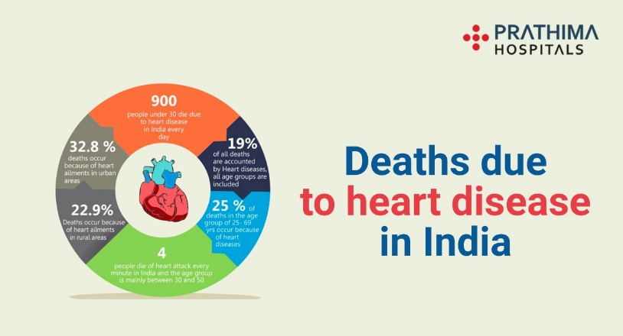
Statistics of CHD in India and worldwide:
. Globally, cardiovascular diseases (CVDs) caused over 17 million deaths in 2016, representing 31% of all global deaths. In India, CVDs are the leading cause of mortality, with a higher death rate than the global average and a significant increase in recent decades. Key statistics show that coronary heart disease is a major concern, often affecting younger people in India and leading to a high economic burden, though rates vary by region.
  Leading cause of death:
. CVDs are the leading cause of mortality in India, with a higher age-standardized death rate than the global average.
  Early onset:
. Indians are likely to develop cardiovascular diseases about a decade earlier than Europeans, with 50% of heart attacks in India occurring in men under 50 in 2022.

Slide 8
Data Collection and Description
This dataset is located at Kaggle website.
The dataset contains 16 attributes in all, of which 15 are independent factors and one variable i.e., TenYearCHD is the dependent variable or target variable.
This data set contains total 4240 data. All attributes in data set are numeric.
Demographic:
Sex: male or female (1-male and 0-female)
Age: Age of the patient;(Continuous - Although the recorded ages have been truncated to whole numbers, the concept of age is continuous)
Education: no further information provided

Slide 9
Data Collection and Description
Behavioural:
Current Smoker: whether or not the patient is a current smoker (Nominal)
Cigs Per Day: the number of cigarettes that the person smoked on average in one day (can be considered continuous as one can have any number of cigarettes, even half a cigarette.)
Information on medical history:
BP Meds: whether or not the patient was on blood pressure medication (Nominal)
Prevalent Stroke: whether or not the patient had previously had a stroke (Nominal)
Prevalent Hyp: whether or not the patient was hypertensive (Nominal)
Diabetes: whether or not the patient had diabetes (Nominal)

Slide 10
Data Collection and Description
Information on current medical condition:
Tot Chol: total cholesterol level (Continuous)
Sys BP: systolic blood pressure (Continuous)
Dia BP: diastolic blood pressure (Continuous)
BMI: Body Mass Index (Continuous)
Heart Rate: heart rate (Continuous - In medical research, variables such as heart rate though in fact discrete, yet are considered continuous because of large number of possible values.)
Glucose: glucose level (Continuous)
Target variable to predict:
10year risk of coronary heart disease (CHD) - (binary: “1”, means “Yes”, “0” means “No”)

Slide 11
Attribute Description
Age | (32-70)
Sex | 0=Female, 1=Male
Education | It takes values as: 1=High School, 2=High School or above, 3=College or Vocational School, 4=College
Current Smoker | 0=No 1=Yes
Cigs Per Day | Number of Cigarettes smoked Per Day (0-70)
BP Meds | 0=No 1=Yes
Prevalent Stroke | 0=No 1=Yes

Slide 12
Attribute Description
Prevalent Hyp | 0=No 1=Yes
Diabetes | 0=No 1=Yes
Tot Chol | Serum Cholesterol (107-696) (mg/dl)
Sys BP | (83.5-295) (mm/hg)
Día BP | (48-142.5) (mm/hg)
Body Mass Index | (15.54-56.8)
Heart Rate | Heart Rate achieved (44-143)
Glucose | (40-394) (mg/dl)
10-year CHD | 0=Healthy, 1=Diseases

Slide 13
Software Requirements
Python Packages to be installed
pandas- used to provide fast, flexible and expressive data structures to make working with “relational” or “labeled” data both easy and intuitive.
numpy: To work with arrays
tkinter- used for developing Graphical User Interface (GUI).
sklearn- efficient for data mining and data analysis. It contains a number of algorithms which can be implemented directly when required.
matplotlib- contains modules which are used for plotting graphs.
Seaborn – used for Graphical Presentation

Slide 14
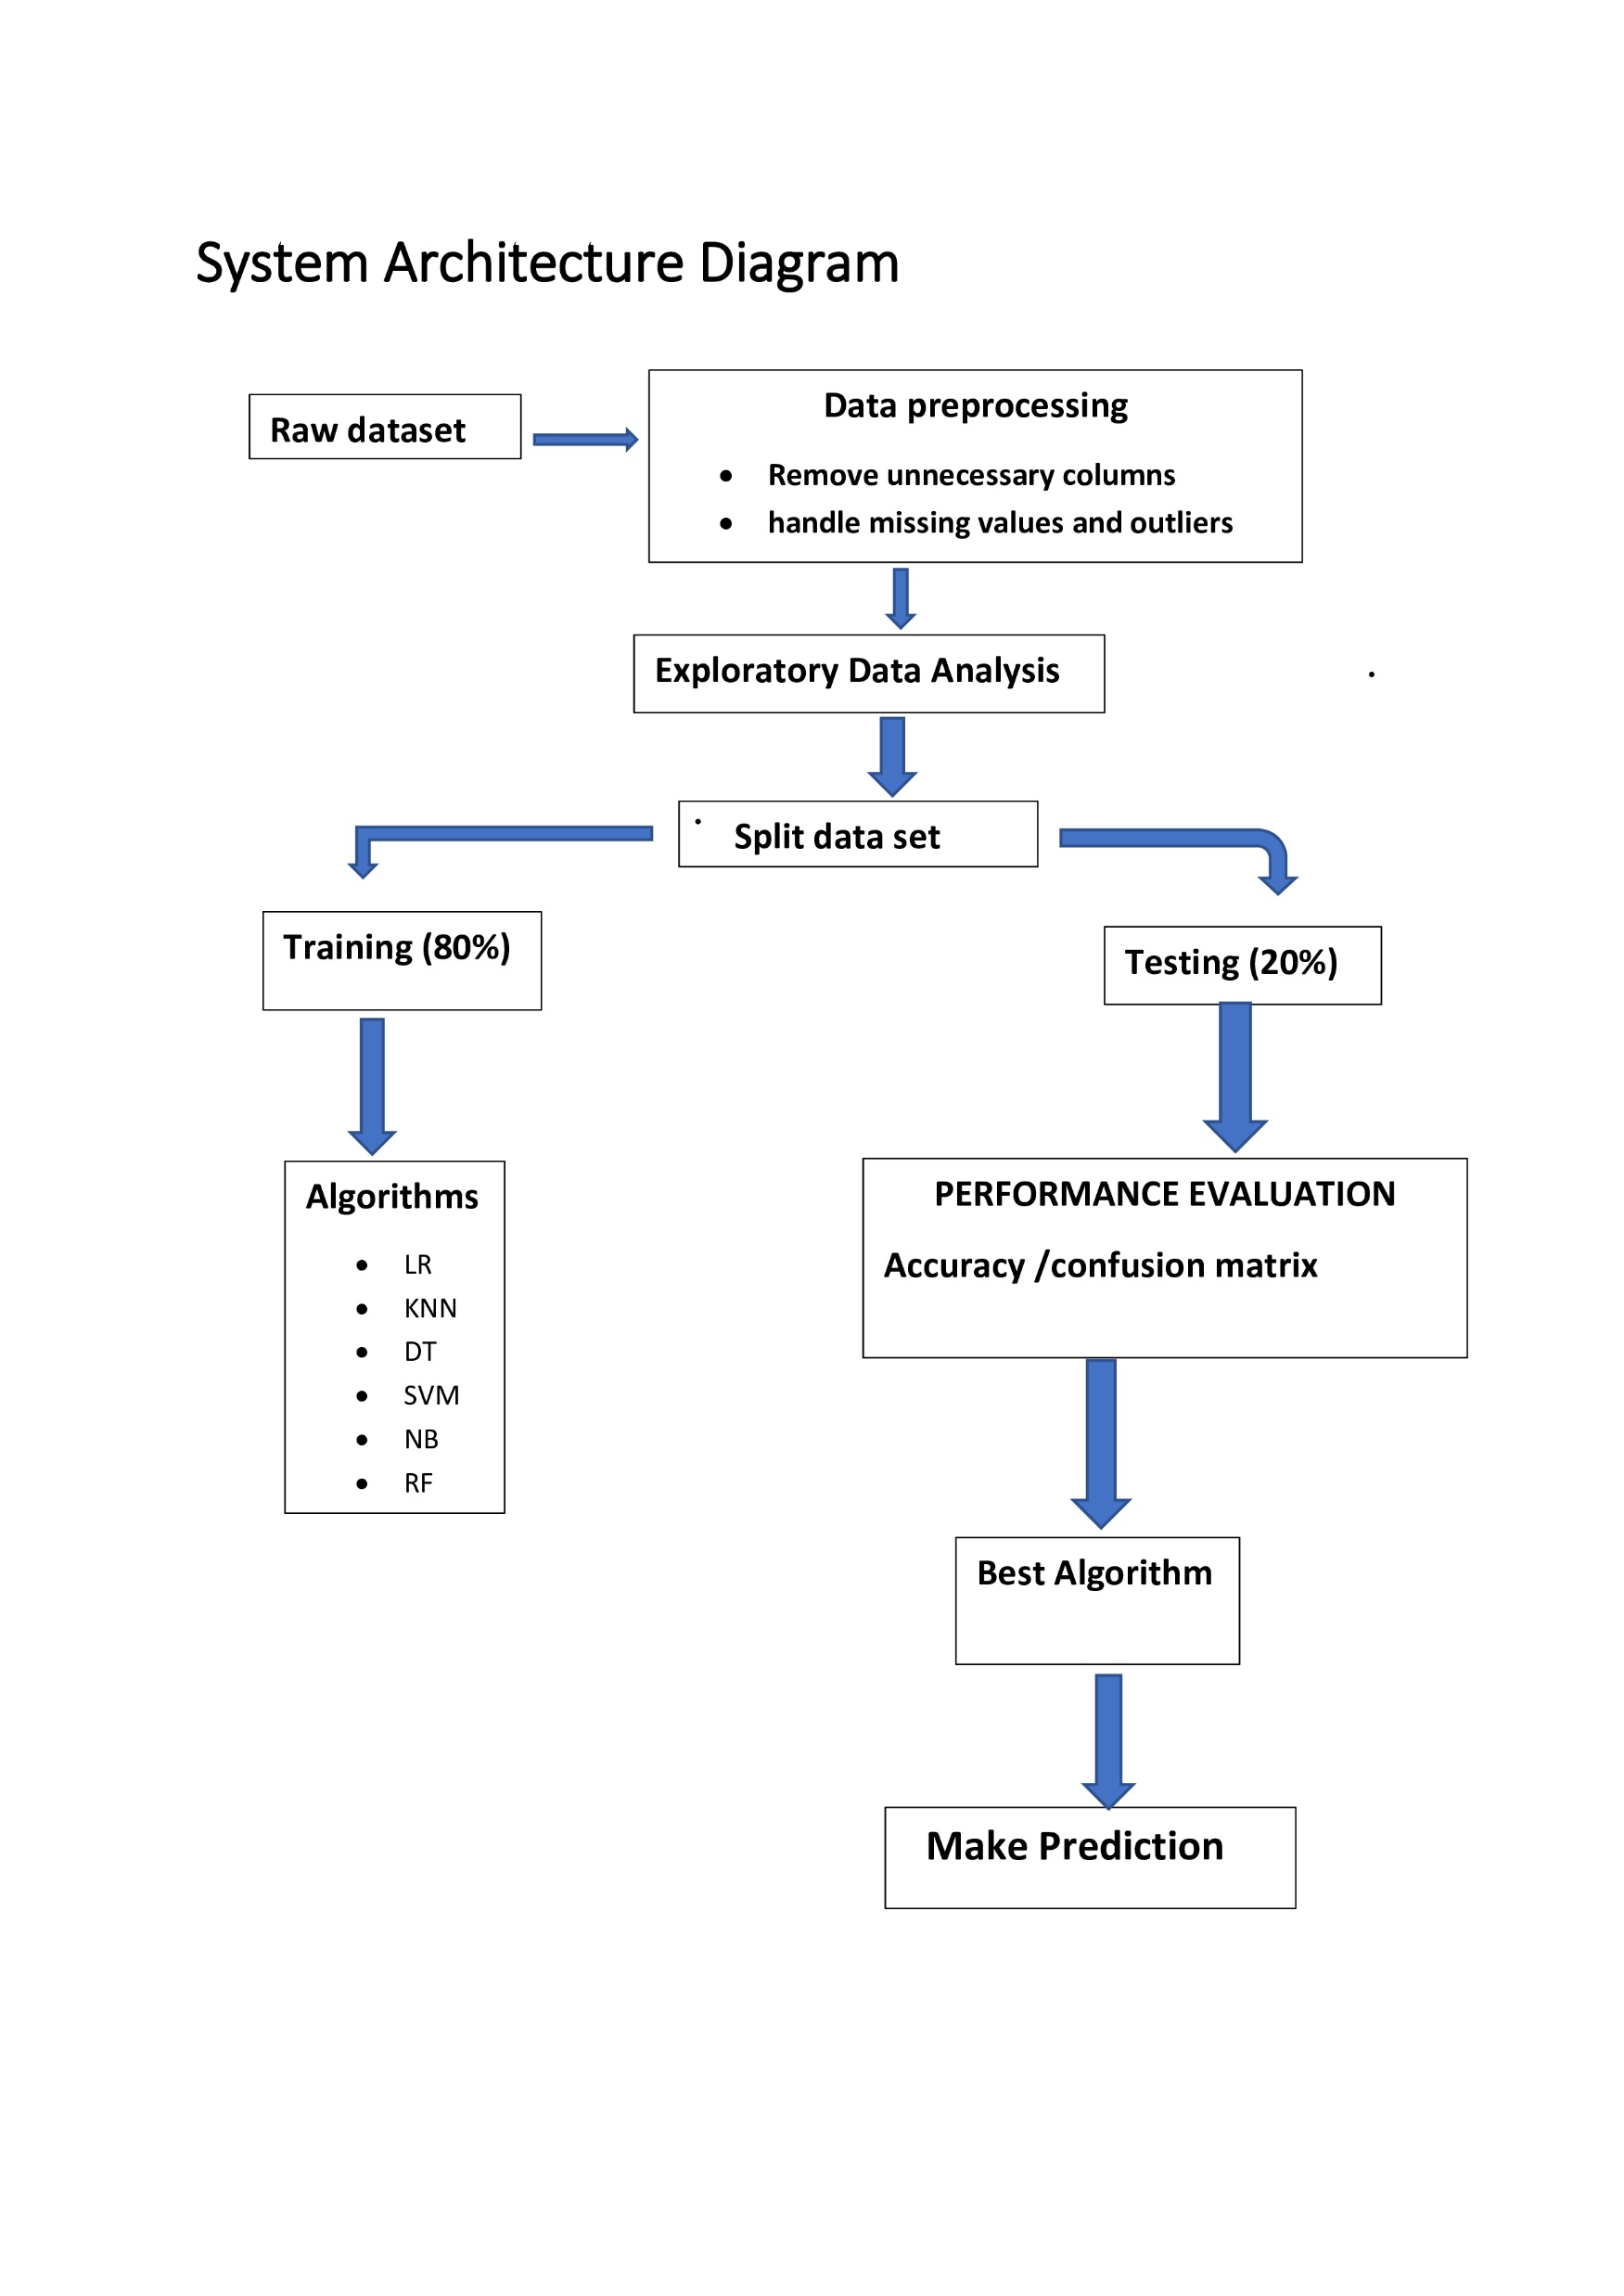
System Architecture Diagram

Slide 15
Data Preprocessing
Data preprocessing is a group of techniques that are applied on the data to improve the quality of the data. Raw data can be converted to useful data. It uses various techniques such as handling missing values, detecting outliers, removing un wanted attributes etc.
Once data is cleaned then it can be used in machine learning models for training. Data preprocessing is one of the most important steps involved in predictive modelling.
Steps followed in data preprocessing
Education column is removed as it has no relation with heart disease
Most corelated features are found by using correlation matrix(heatmap).
Sysbp and Diabp are highly corelated
Current smoker and Cigsperday are highly corelated.so only one of them is selected.
Missing values are handled by imputation .
Outliers found and removed.
Duplicated rows removed.
Features have been standardized by using Standard Scaler .

Slide 16
Exploratory Analysis
Exploratory Data Analysis (EDA) is an approach to analyse the data using visual techniques. It is used to discover trends, patterns, or to check assumptions with the help of statistical summary and graphical representations.

Slide 17
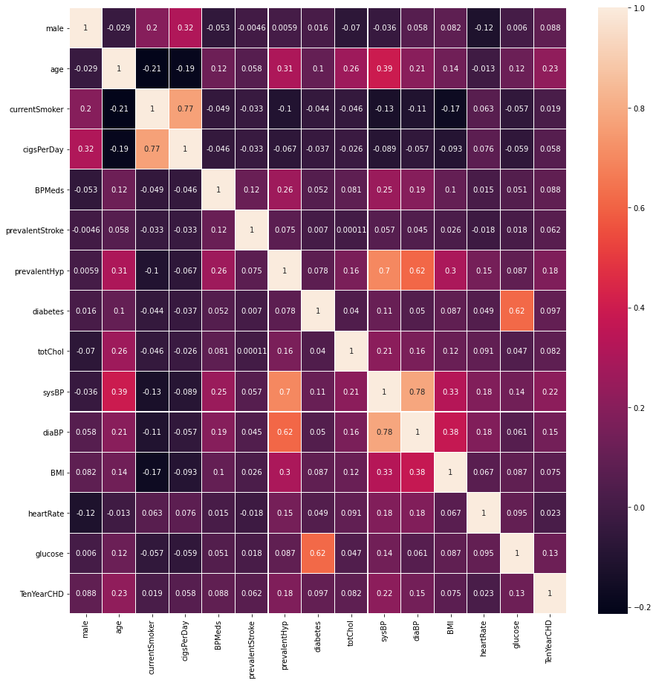
Corelation Matrix

Slide 18
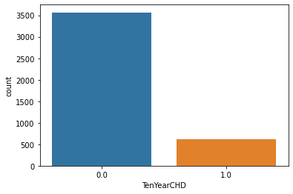
No of people suffer from heart disease and not

Slide 19
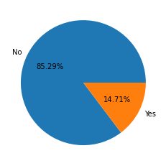
Pie Chart showning percentage of people with and wit out heart disease

Slide 20
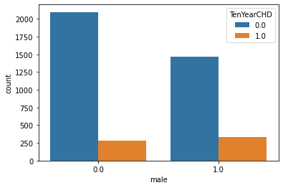
Male and female with and with out disease

Slide 21
Data splitting
Splitting dataset
Data set is splitted into training and testing subsets .
For training 80% data and for testing 20% of data is selected .

Slide 22
Algorithms used
For building machine learning model following algorithms Are used.
KNearest Neighbors
Logistic Regression
Decision Tree
Naive Bayes
Support Vector Machine
Random Forest

Slide 23
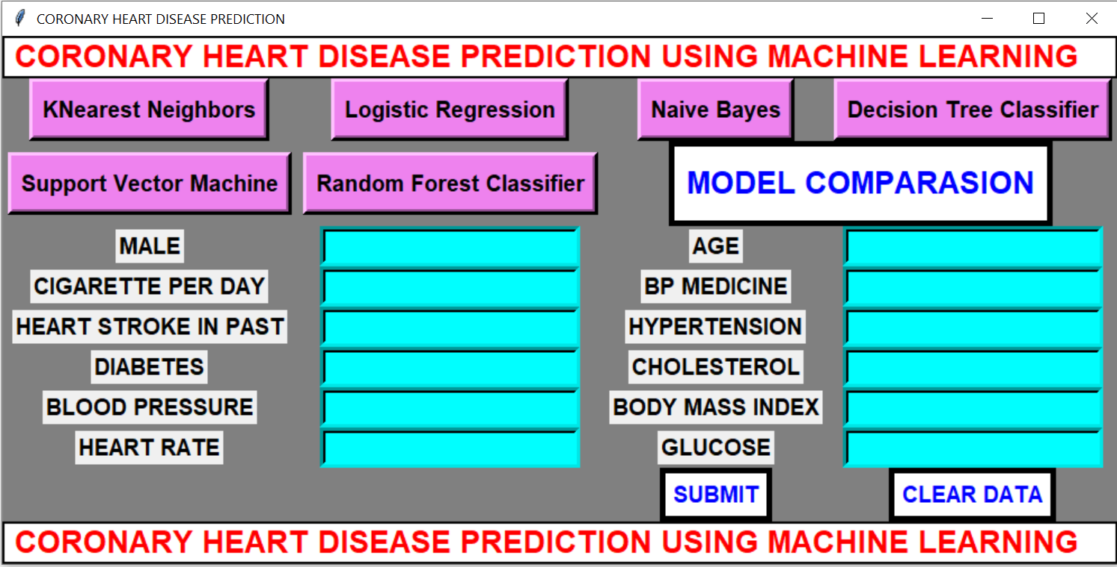
GUI Implementation

Slide 24
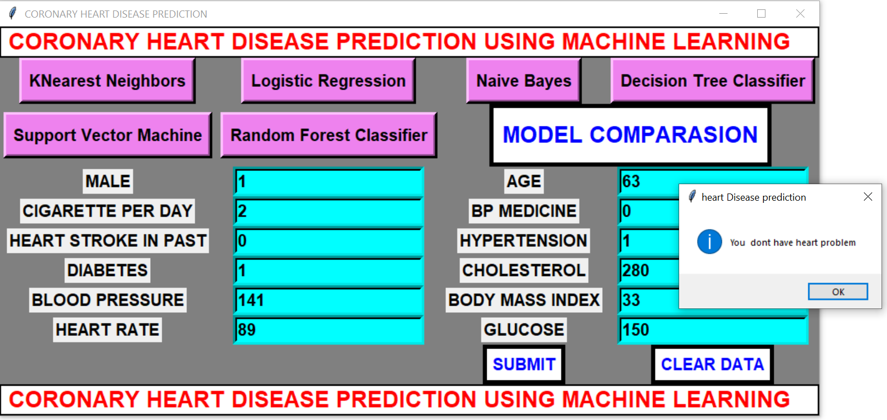
GUI Implementation

Slide 25
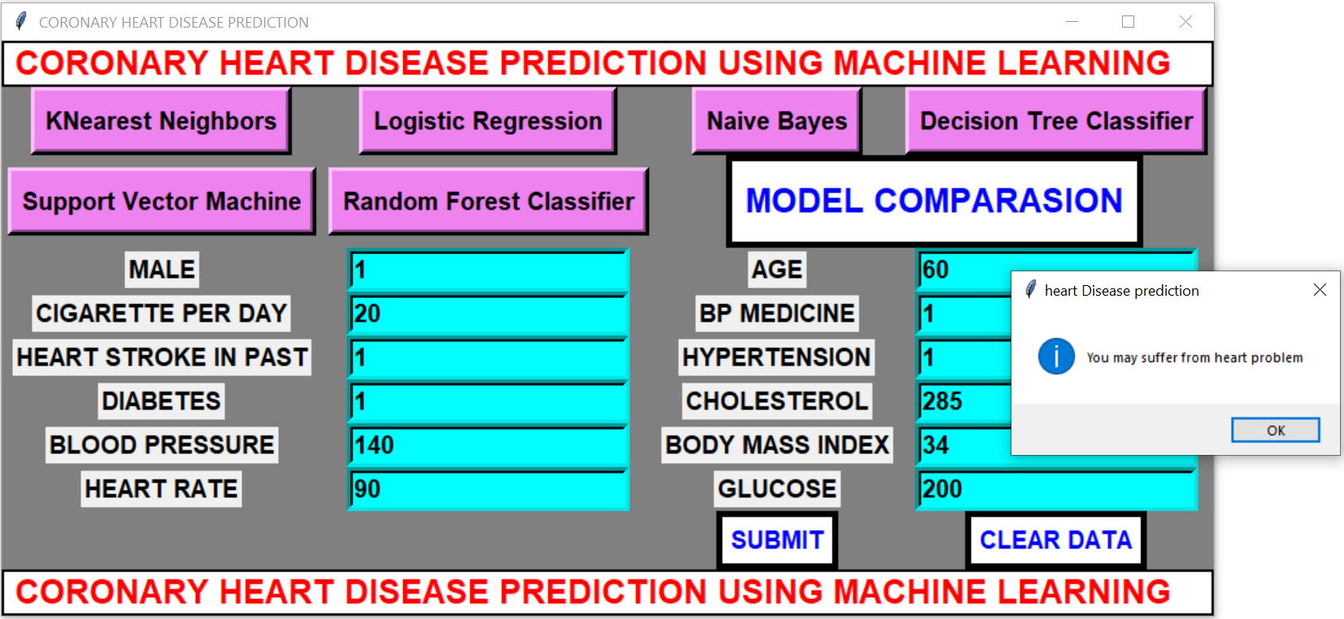
GUI

Slide 26
Conclusion
In this project six different machine learning algorithms are applied for prediction of heart disease.
They are Logistic Regression, K-nearest Neighbours, Naïve Bayes, Decision Tree, Random Forest and SVM .
Accuracy of Logistic Regression is 86.26%, K-nearest Neighbours is 85.42%, Naïve Bayes is 83.63%, Decision Tree is 83.03%, Random forest is 86.14% and SVM is 85.9%.
From the above we conclude that Logistic Regression is the best model for coronary heart disease prediction.

Slide 27
Future Work
In this project 6 machine learning algorithms are applied for prediction of coronary heart disease .
It was found that Logistic Regression performs better than other algorithms. Also a GUI is developed for prediction of heart disease.
In future artificial neural networks algorithms will be used to get better accuracy. Also a web based system will be developed so that people from different parts of world can use it.

